Slide 1
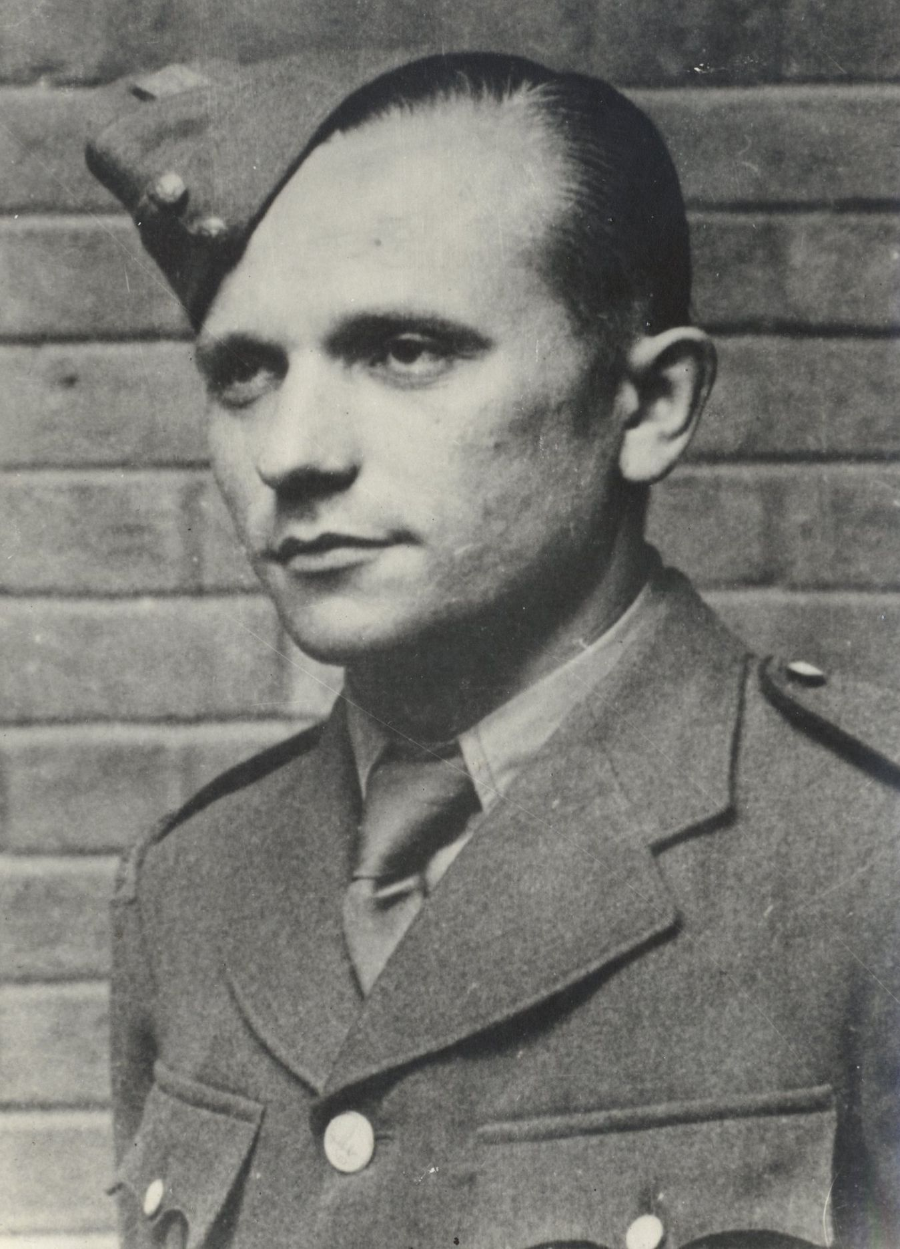
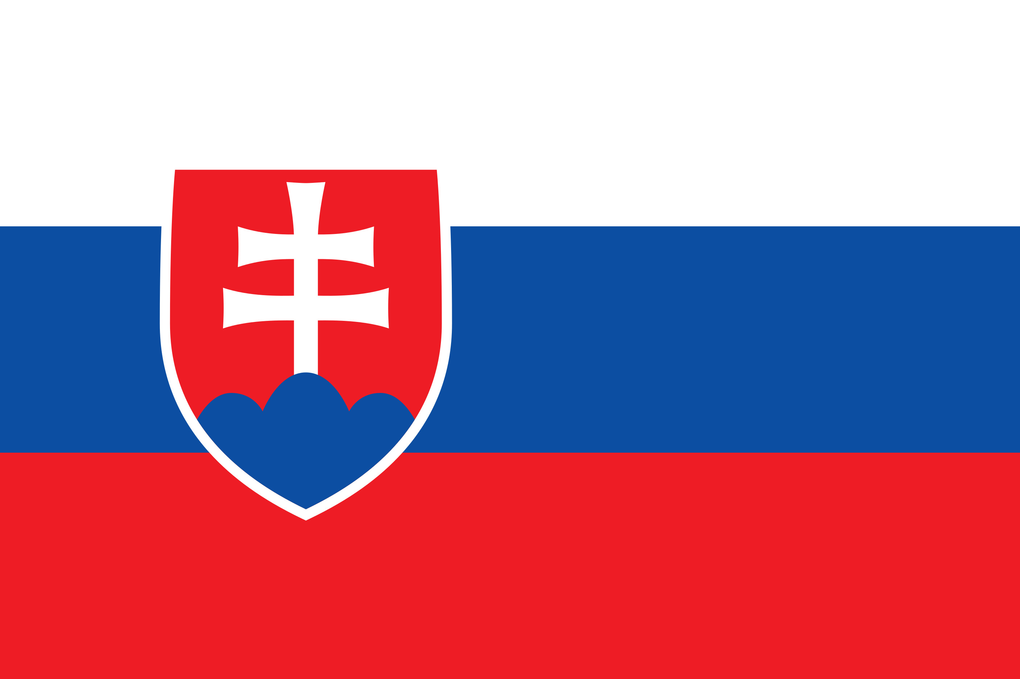
Jozef Gabčík
Life & Operation Anthropoid
Mgr. Marta Majerčík
International Secretary MAFCSVC 2022
for Česká a Slovenská škola Okénko v Londýně

Slide 2
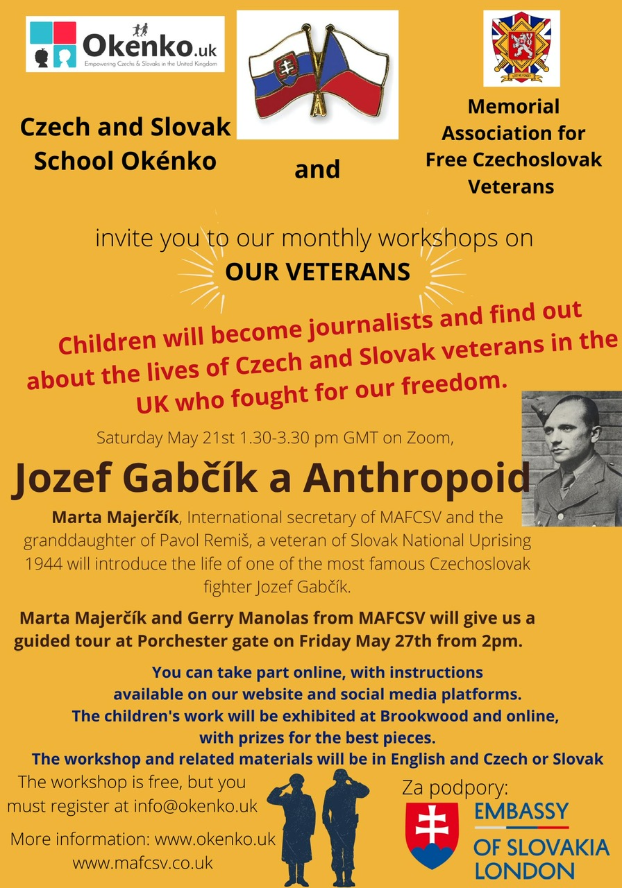
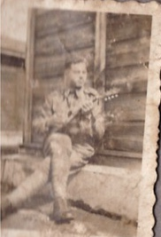
Introduction
Pavol Remiš - Czechoslovak soldier in Slovak Natinoal Uprising 1944

Slide 3
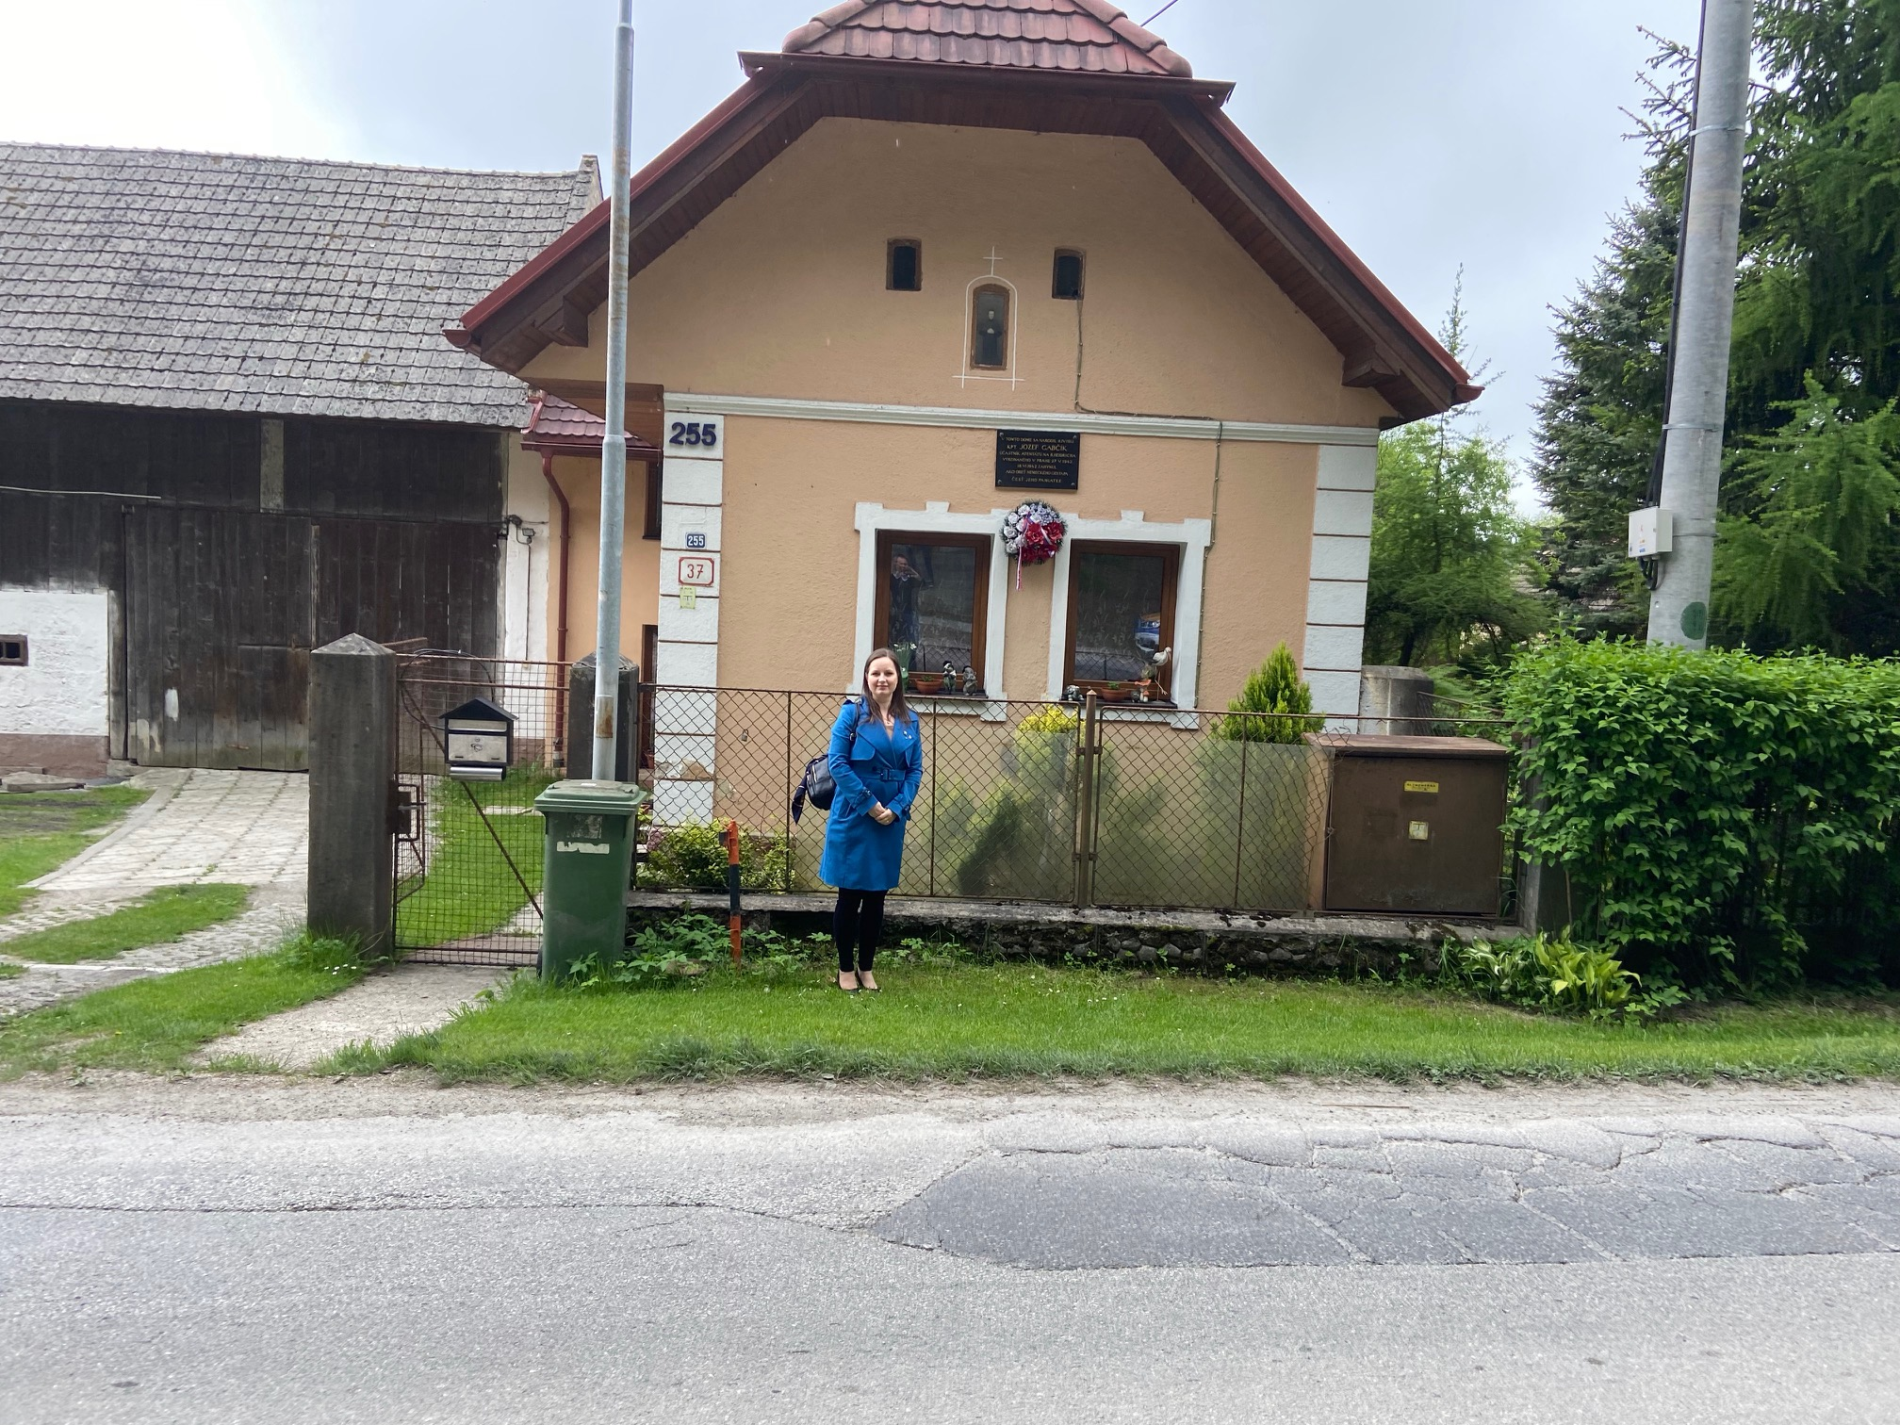
Jozef Gabčík - life
Born 8.4.1912 in Stránské, Austrian – Hungary (now Slovakia)
Grew up in Poluvsie, Rajecké Teplice in family of worker František
After school he learned to be a blacksmith as well as locksmith and bussines studies
1.10.1932 he started his military school
when Czechoslovakia broke up and German soldiers came to a military object he protected it and fled to Poland to join forming Czechoslovak military unit (Czechoslovak legion) then when WW2 started, he went to France to fight

Slide 4
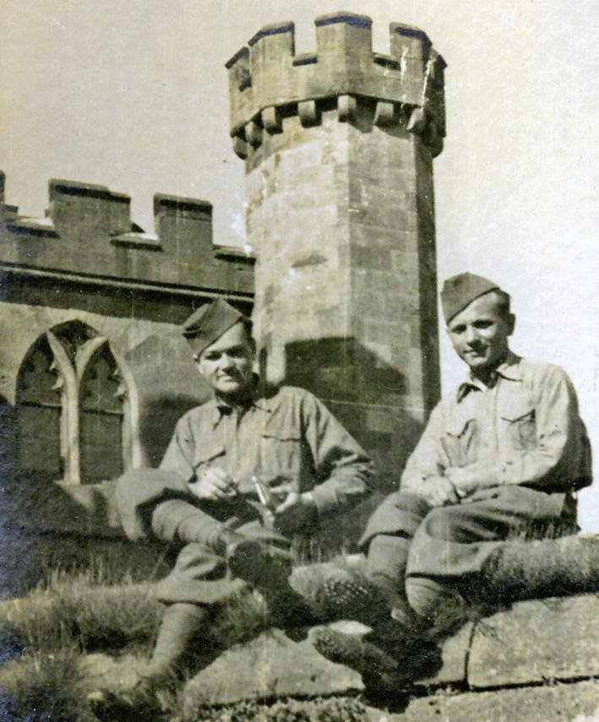
SOE
In UK he and his CS friends from Czechoslovak army in exile were stationed in Cholmodeley Castle gardens and as Jozef was very good in military trainings he was chosen to be trained as a SOE – special operations executive
The soldiers were special agents with perfect physical and mental training. They were transferred in small teams back to their homeland with special missions to do to help their country fight the evil, fight for the freedom and democracy and end the war
Jozef Gabčík and Jan Kubiš (from now Czech republic) were chosen for OPERATION ANTHROPOID created by General František Moravec

Slide 5
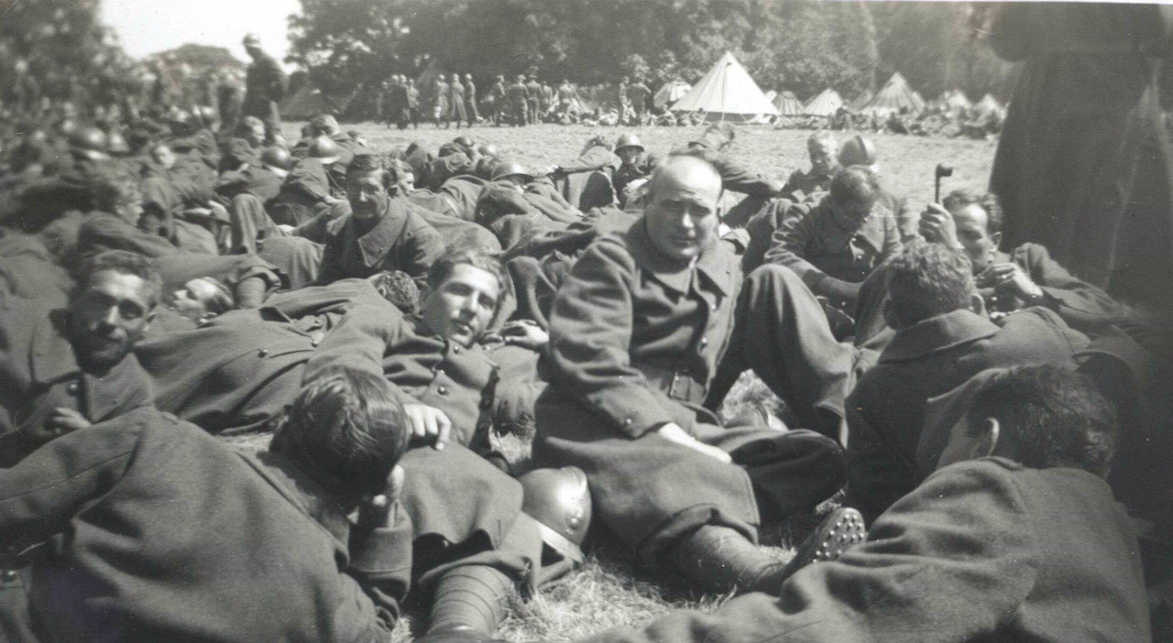
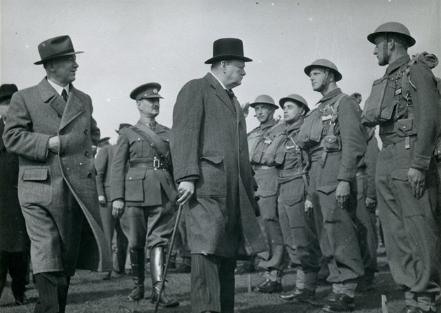
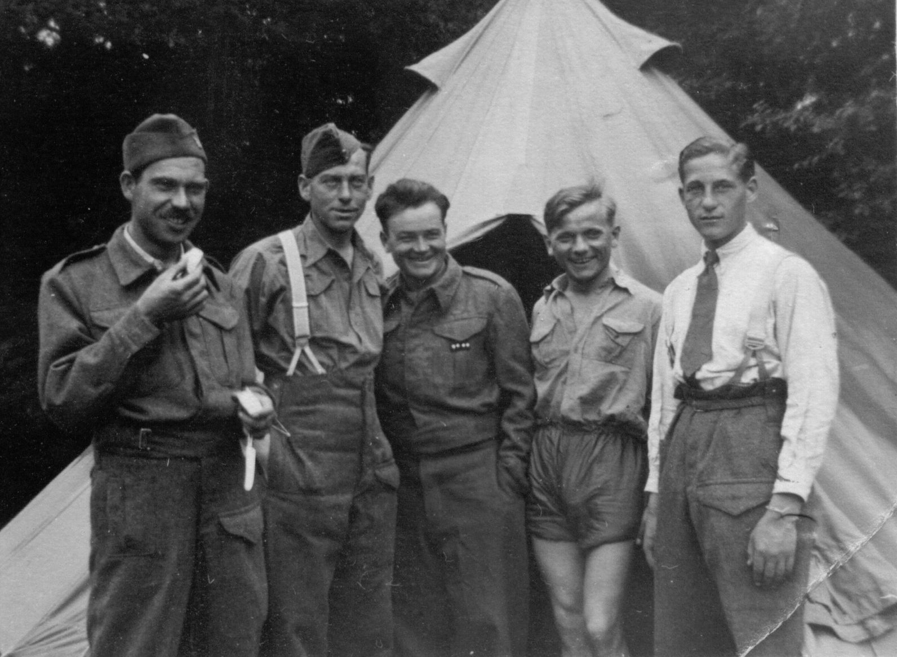
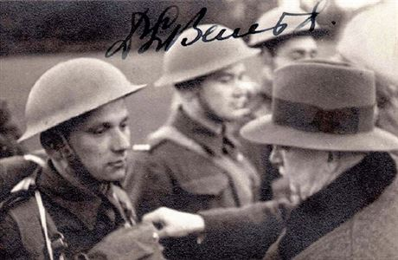
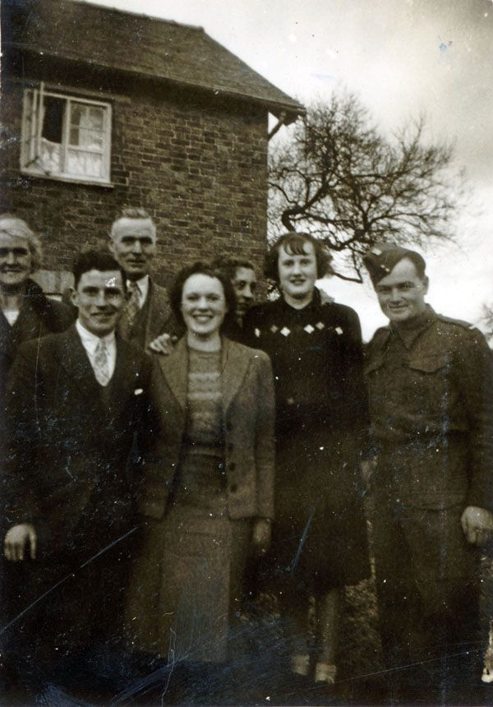
Photos from UK
Ellison family had got a special place in Jozef and Jan’s hearts…

Slide 6
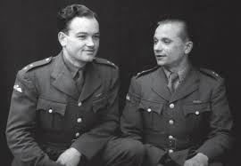
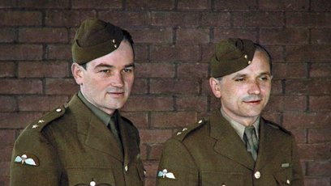
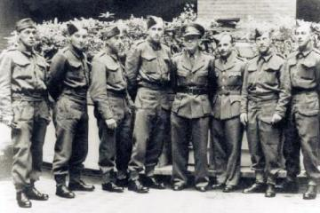
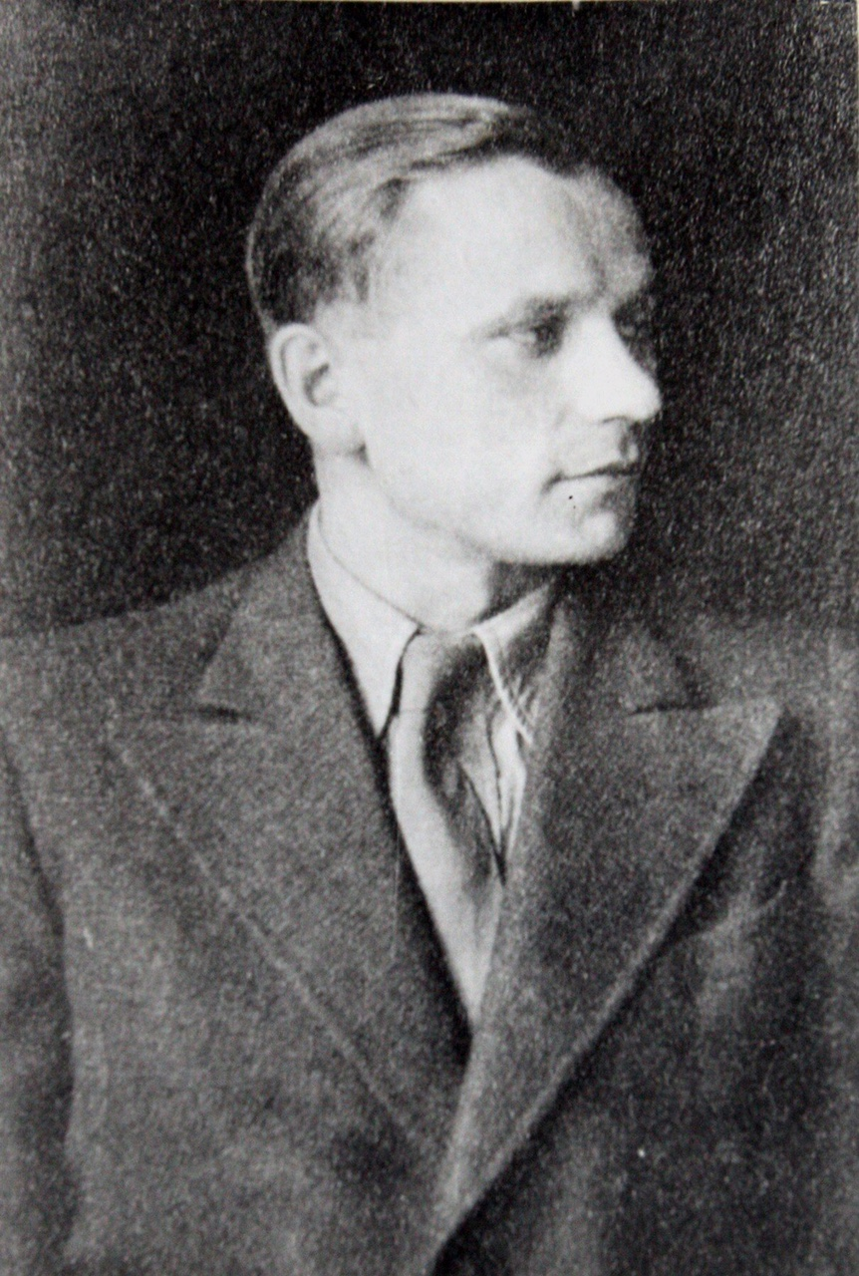
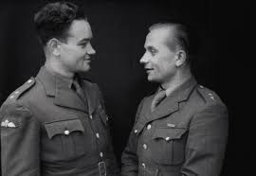
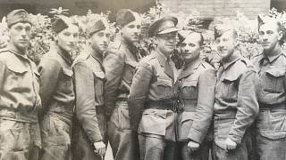
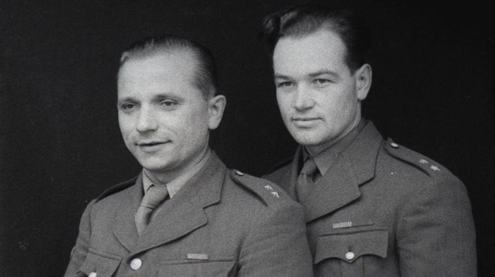
Porchester Gate
Taking photographs before they went for their mission in to homeland (photos were discovered in 2016)

Slide 7
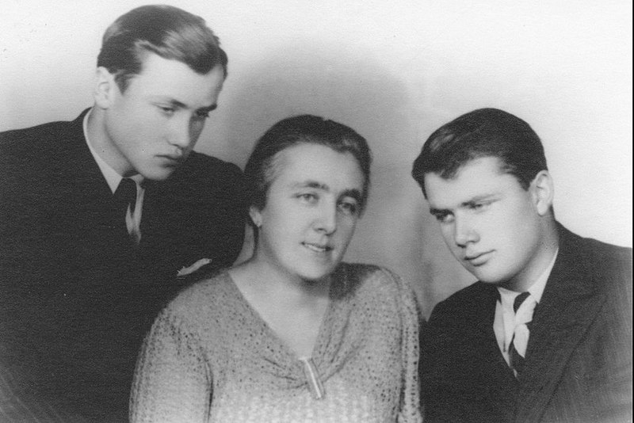
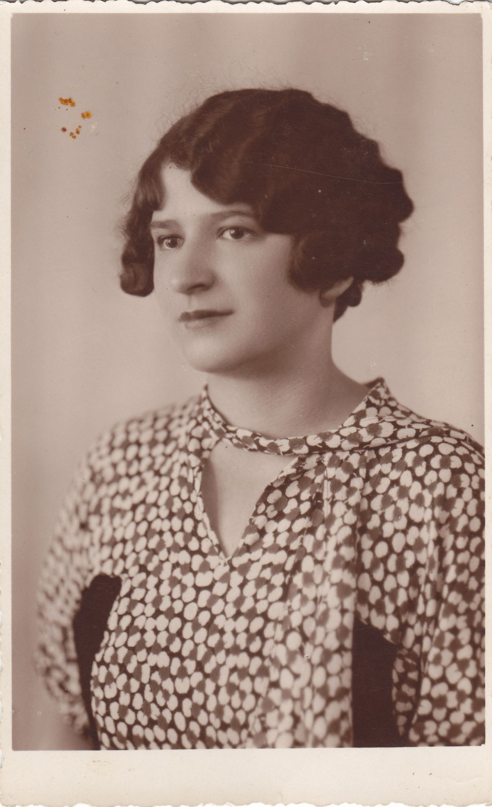
Back at Home
On 28th December 1941 Jozef Gabčík & Jan Kubiš (Anthropoid) with Other soldiers (Silver A, Silver B) flew to Czechoslovakia
In Prague their connected with resistance
They provided them food, shelter, informations, medical care and contacts
The role of women in resistance was very important
Márie Moravcová with Sons Vlastimil & Miroslav
Anna Malinová

Slide 8
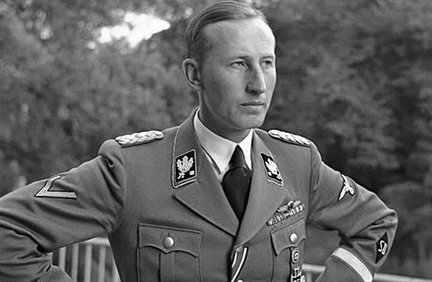
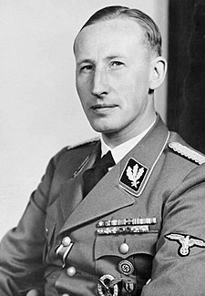
Reinhard Heydrich
The Butcher of Prague
He was 3rd high ranked Nazi German SS (Hitler’s favorite) & (Principal) architect of the Holocaust, chief of Gestapo
While in Prague live in caste Panenské Březany with his wife and two sons
He ordered to kill hundreds of innocence people (Butcher of Prague)
His plan was killed all the Czech people who disagreed to become German

Slide 9
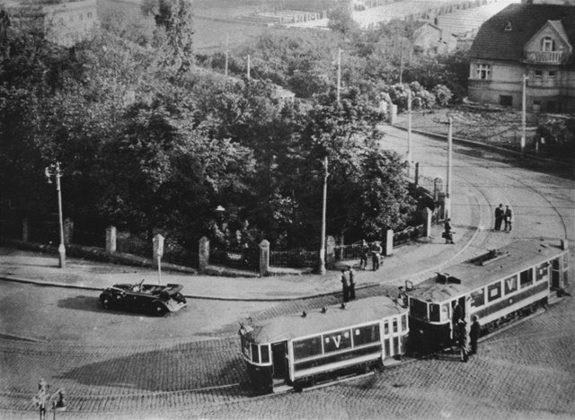
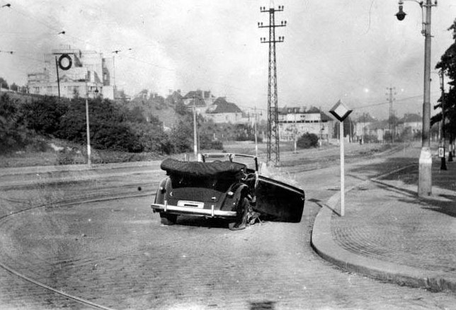
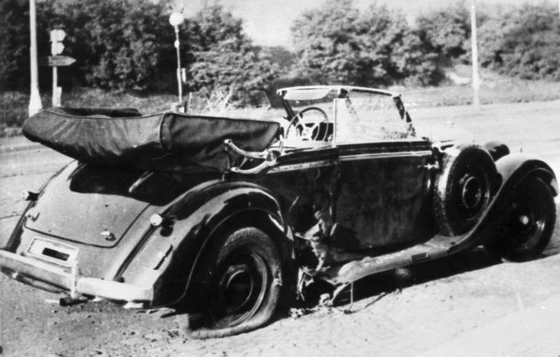
ANTHROPOID
In the morning 27th May 1942 Jozef Gabčík and Ján Kubiš attacked the car with Heydrich and his Driver with Sten gun and anti-tank grenade
Heavily injured Heydrich was transported to hospital

Slide 10
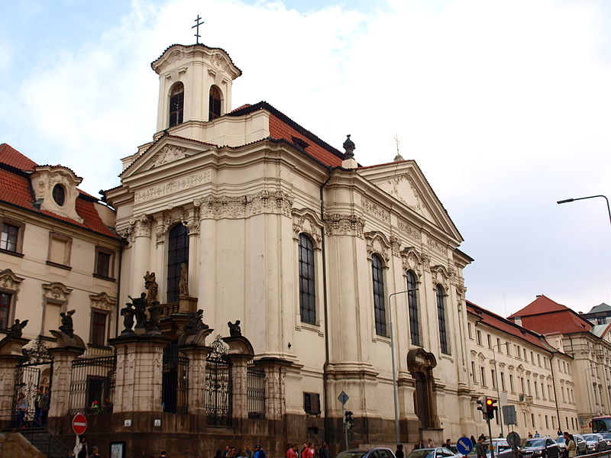
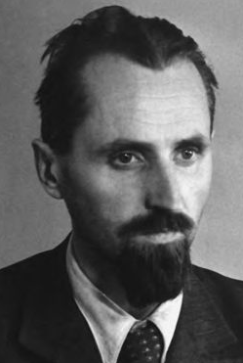
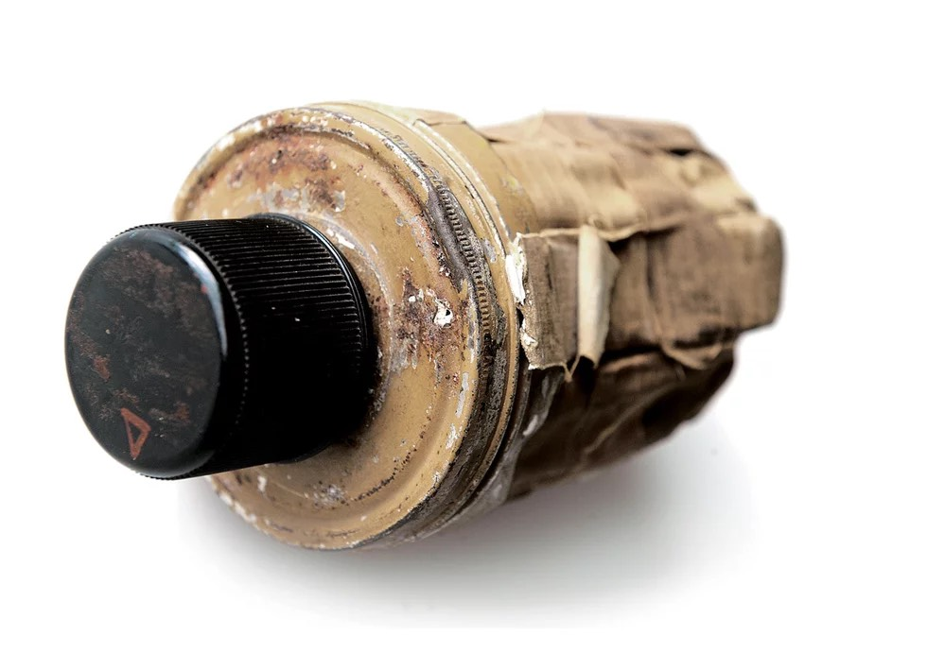
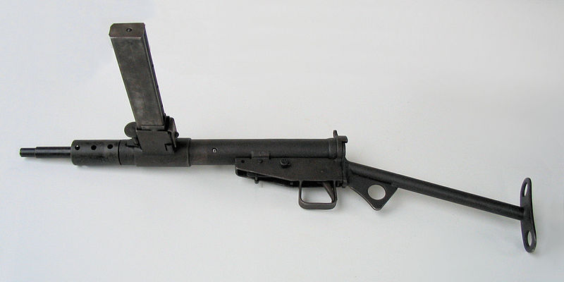
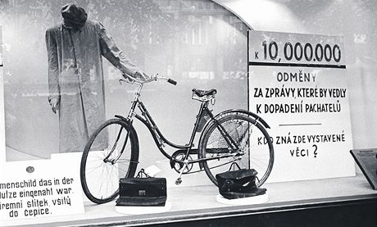
Church
(“We will never surrender!”)
They hide in Cyril & Methodius Cathedral in Prague along with the other parachutists: Adolf Opálka, Jan Hrubý, Josef Valčík, Jaroslav Švarc and Josef Bublík
The resistance was still helping them while Nazis (Gestapo) were looking for “2 assassins”
Father Vladimír Petřek

Slide 11
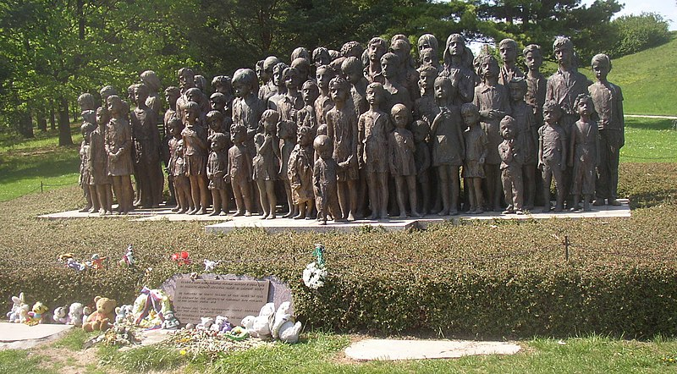
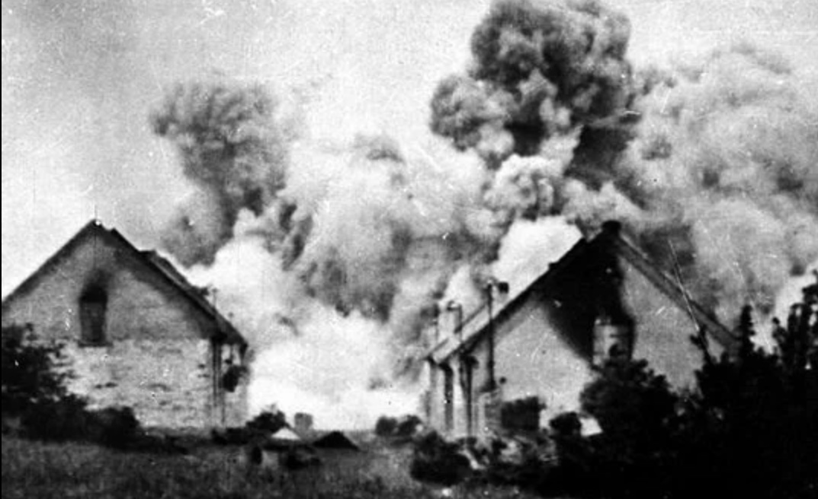
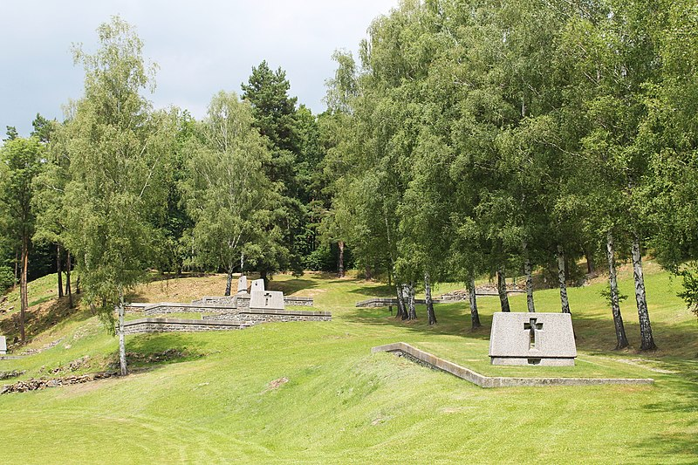
Lidice & Ležáky
Reprisals
No one was helping Nazis to find parachutists, so they wanted to scare people
They destroyed villages Lidice and Ležáky to the ground
All the men were killed, women were transported to concentration camps and most of the children were killed, only few survived and were ‘germanized'
The World was outraged!

Slide 12
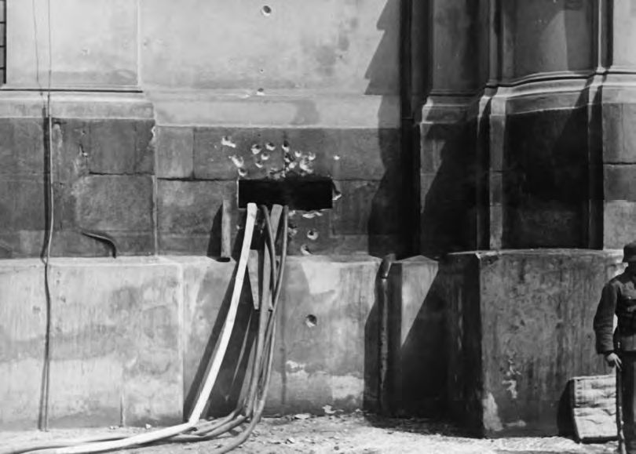
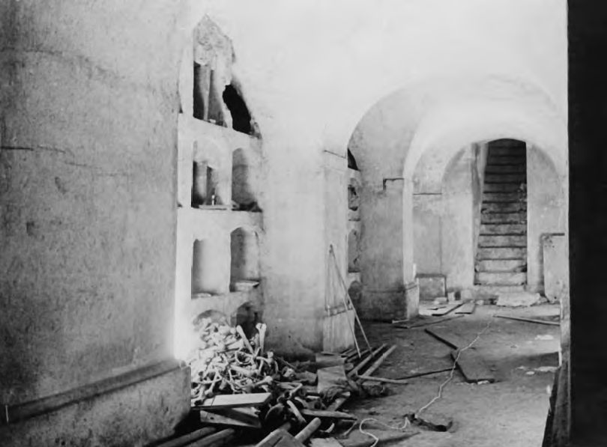
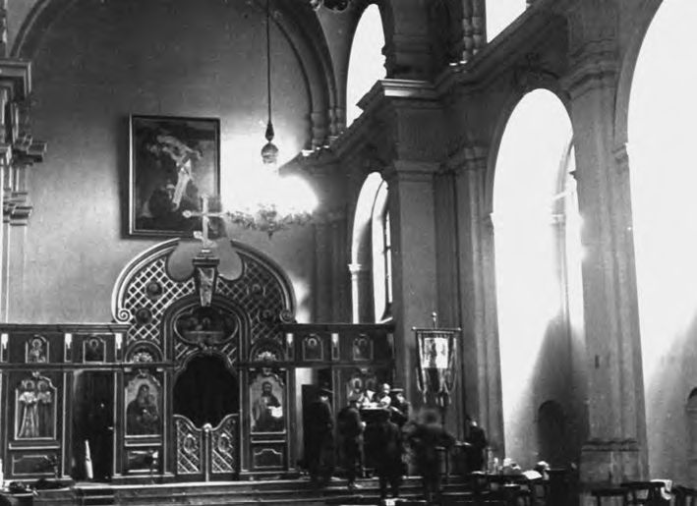
The last Fight
After Karel Čurda’s betrayal, Gestapo started evil arresting, torturing and killing (Mauthausen) the people of resistance
After finding out their hiding place a six hours battle started in the church
Seven brave soldiers against 800 German soldiers and their helpers
Gabčík and the 6 others committed suicide to avoid to get in Nazis hands
Kubiš was wounded and died at the hospital

Slide 13
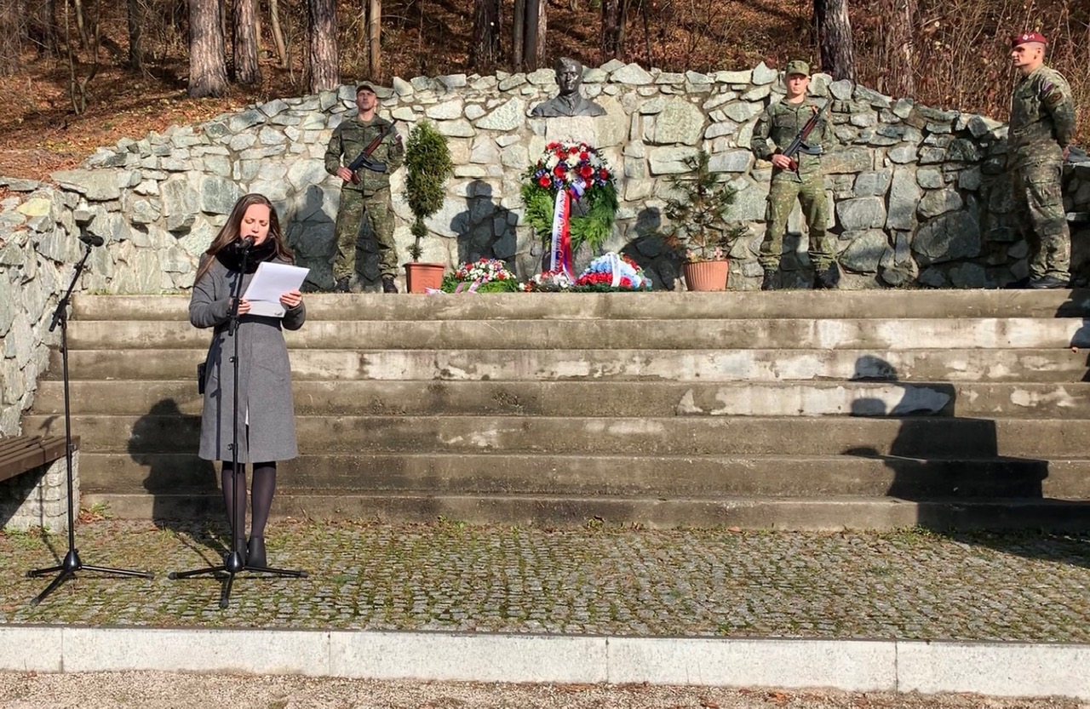
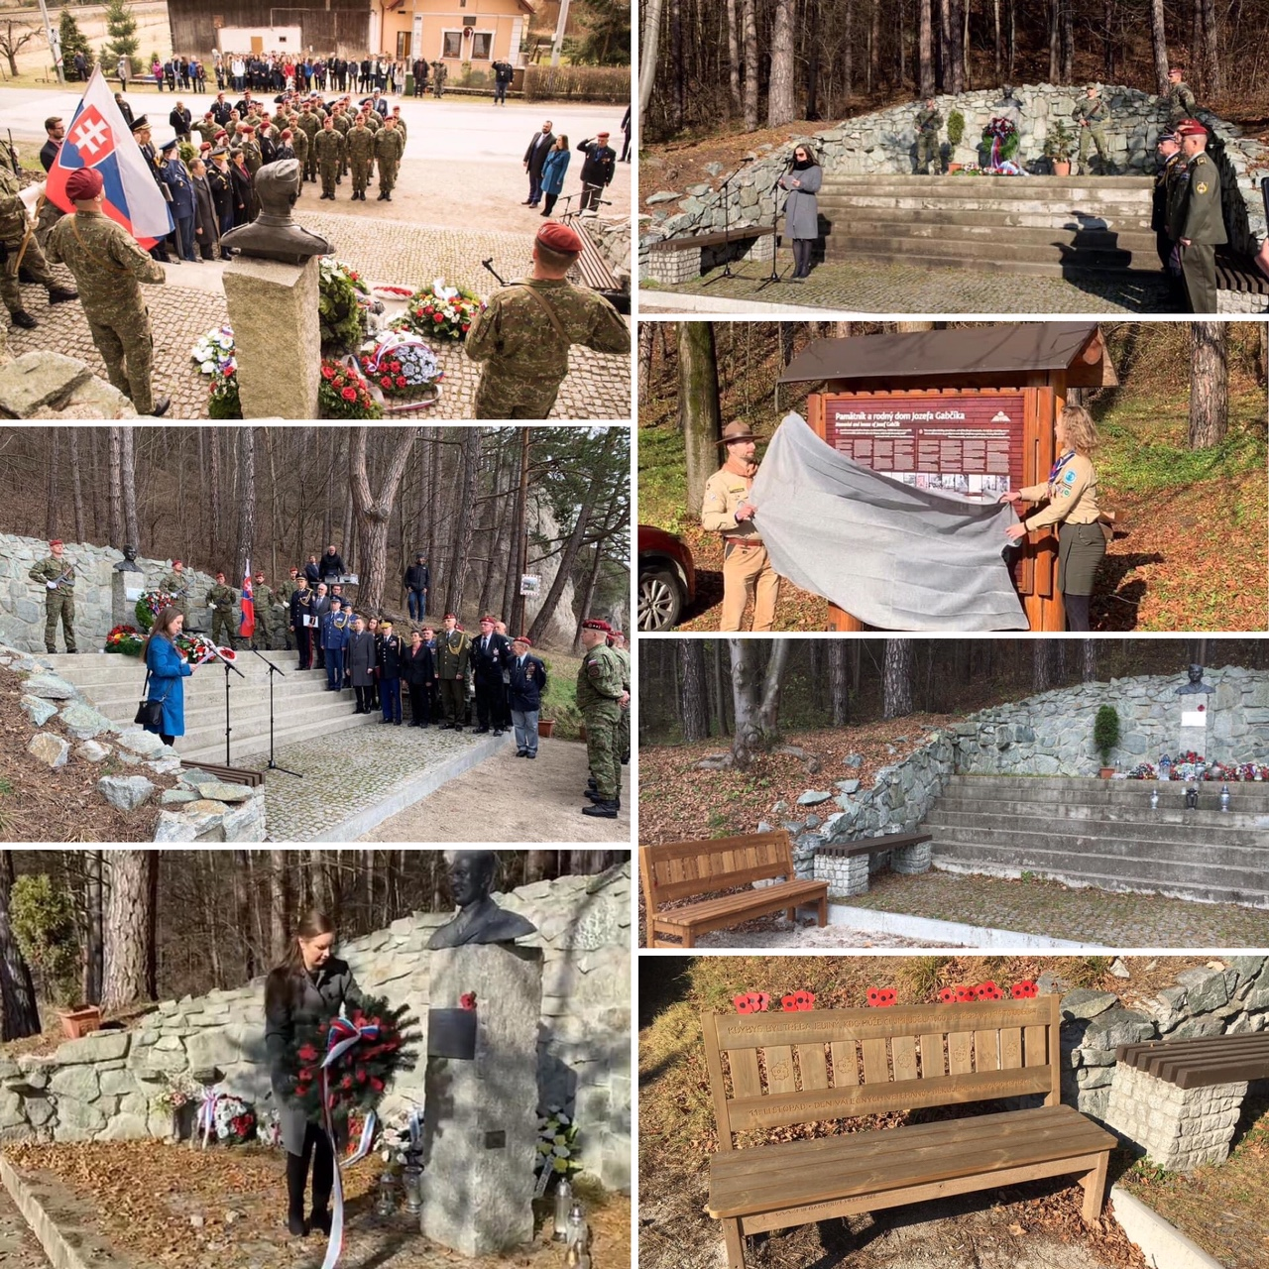
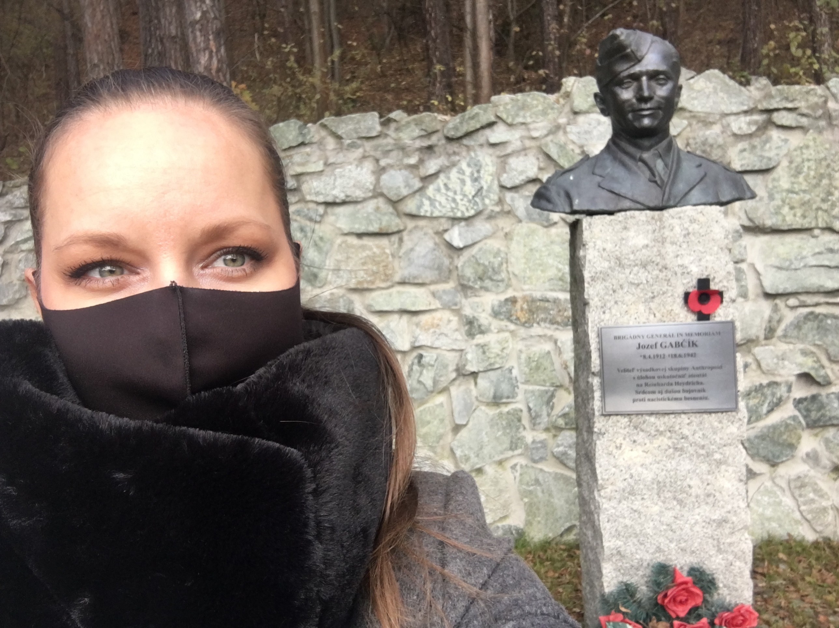
Remembering

Slide 14
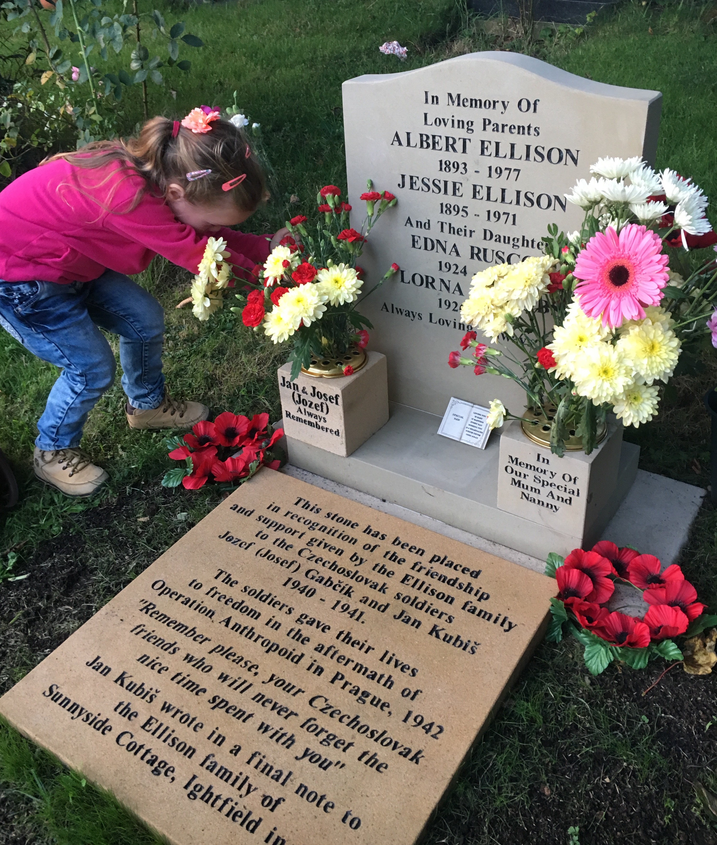
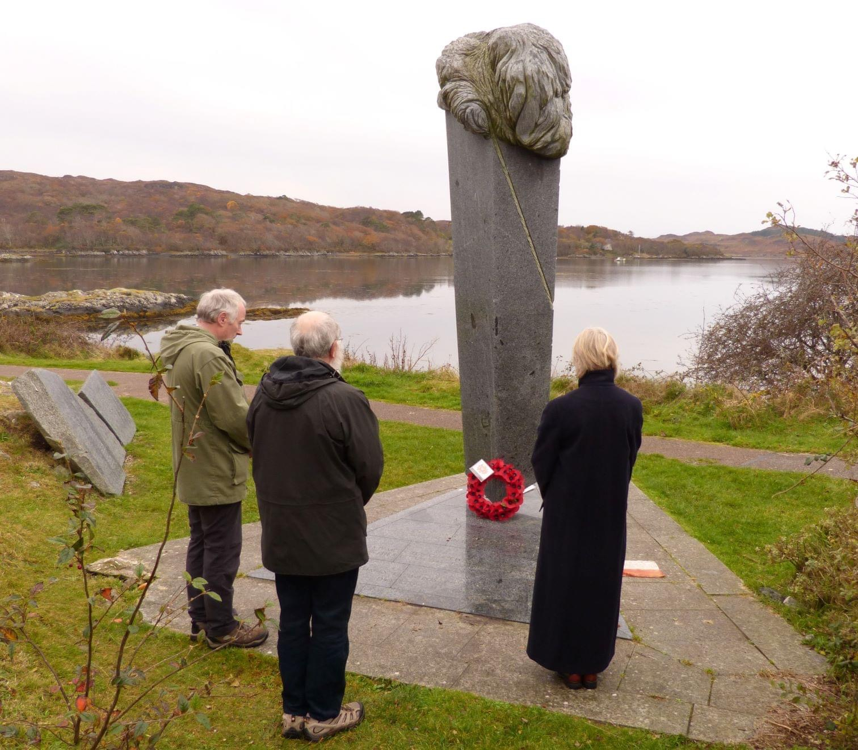
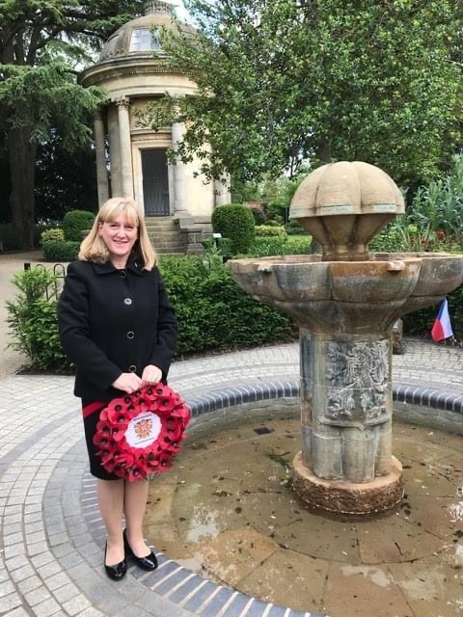
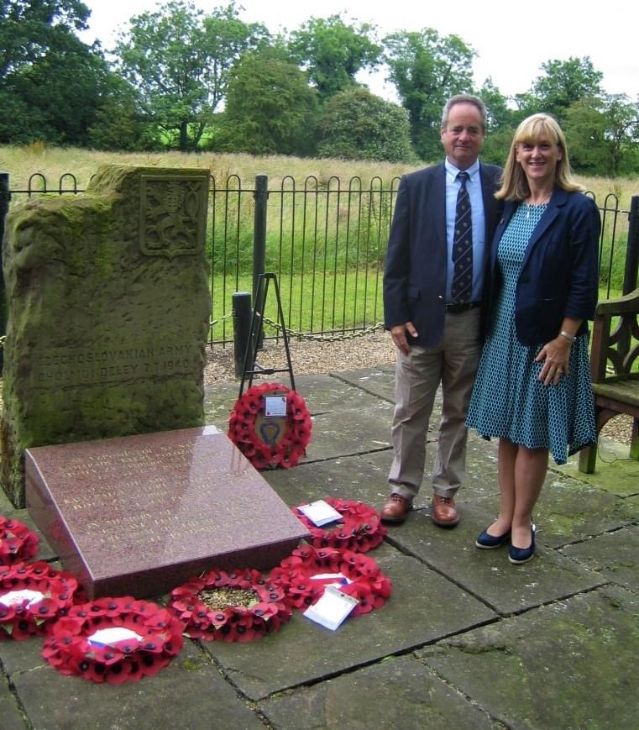
UK
Arisaig, Scotland
Ightfield
Leamington Spa
Cholmondeley

Slide 15
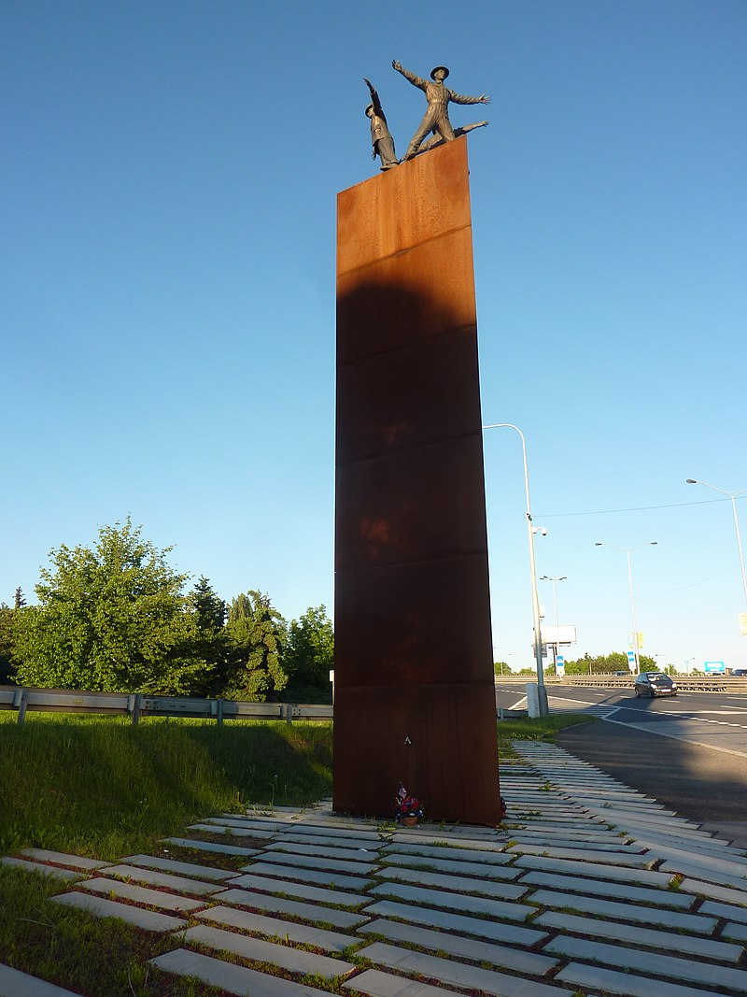
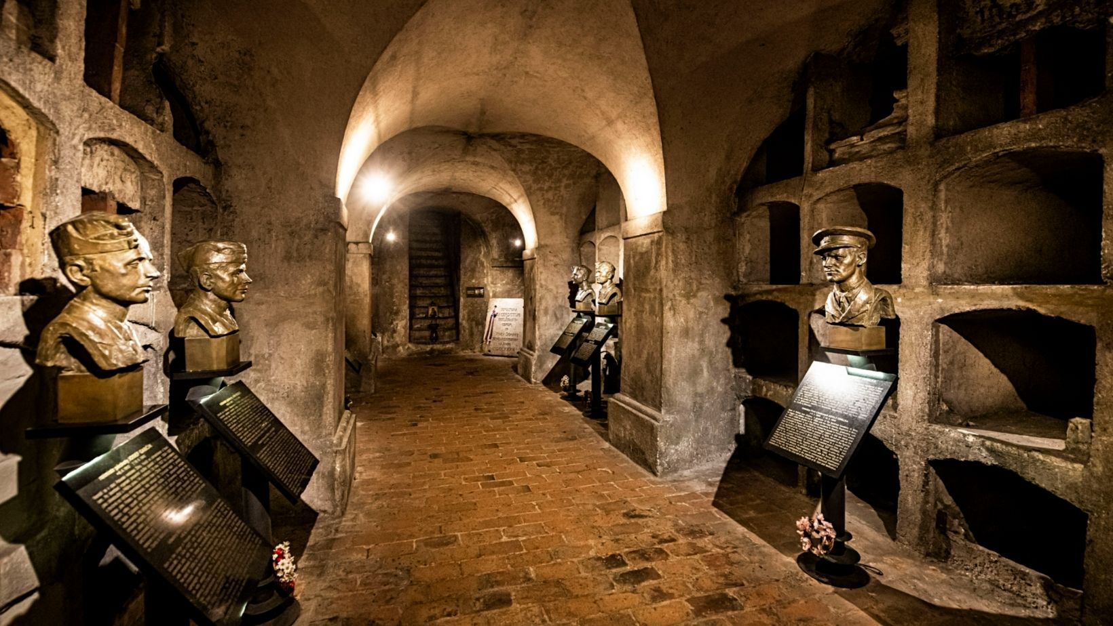
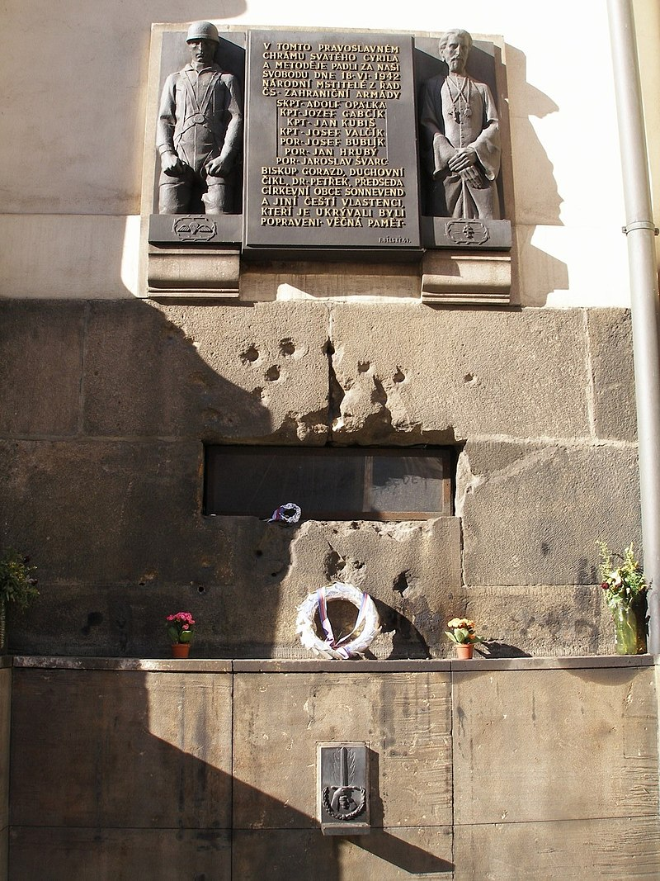
Czech Republic
Prague

Slide 16
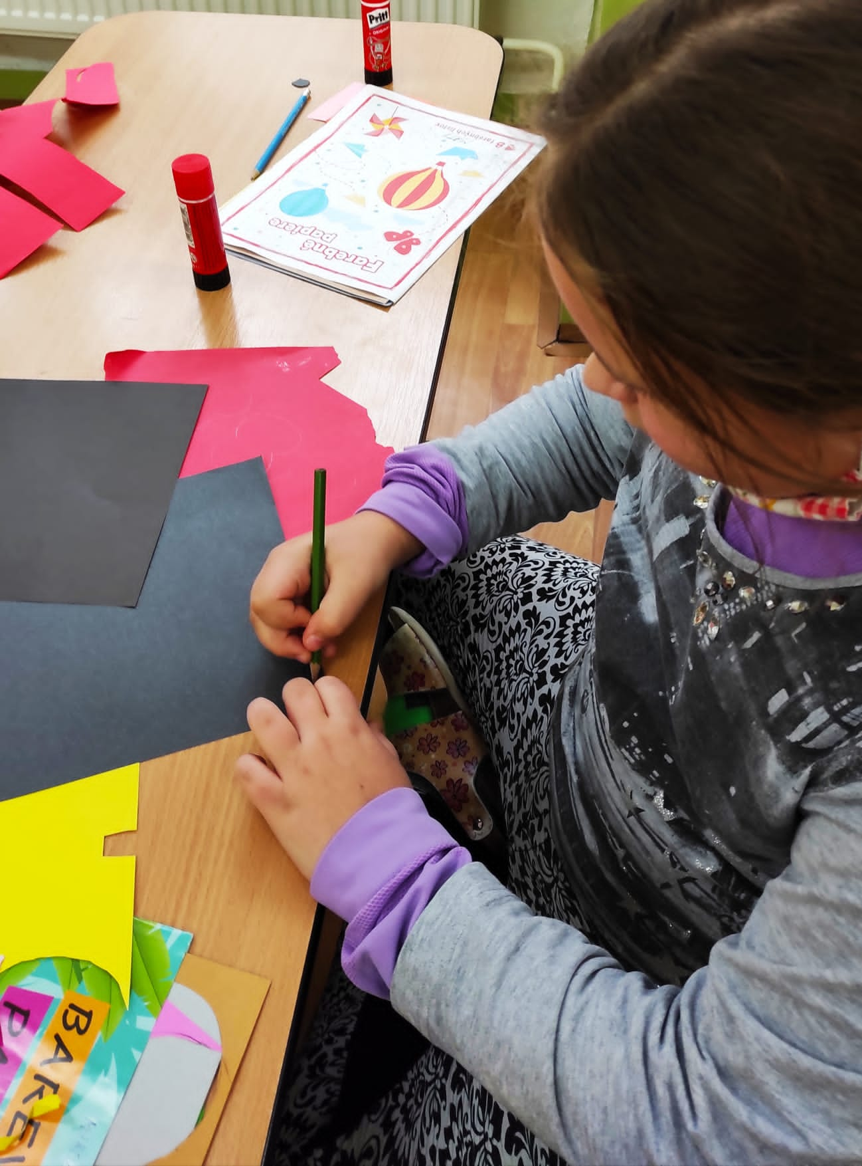
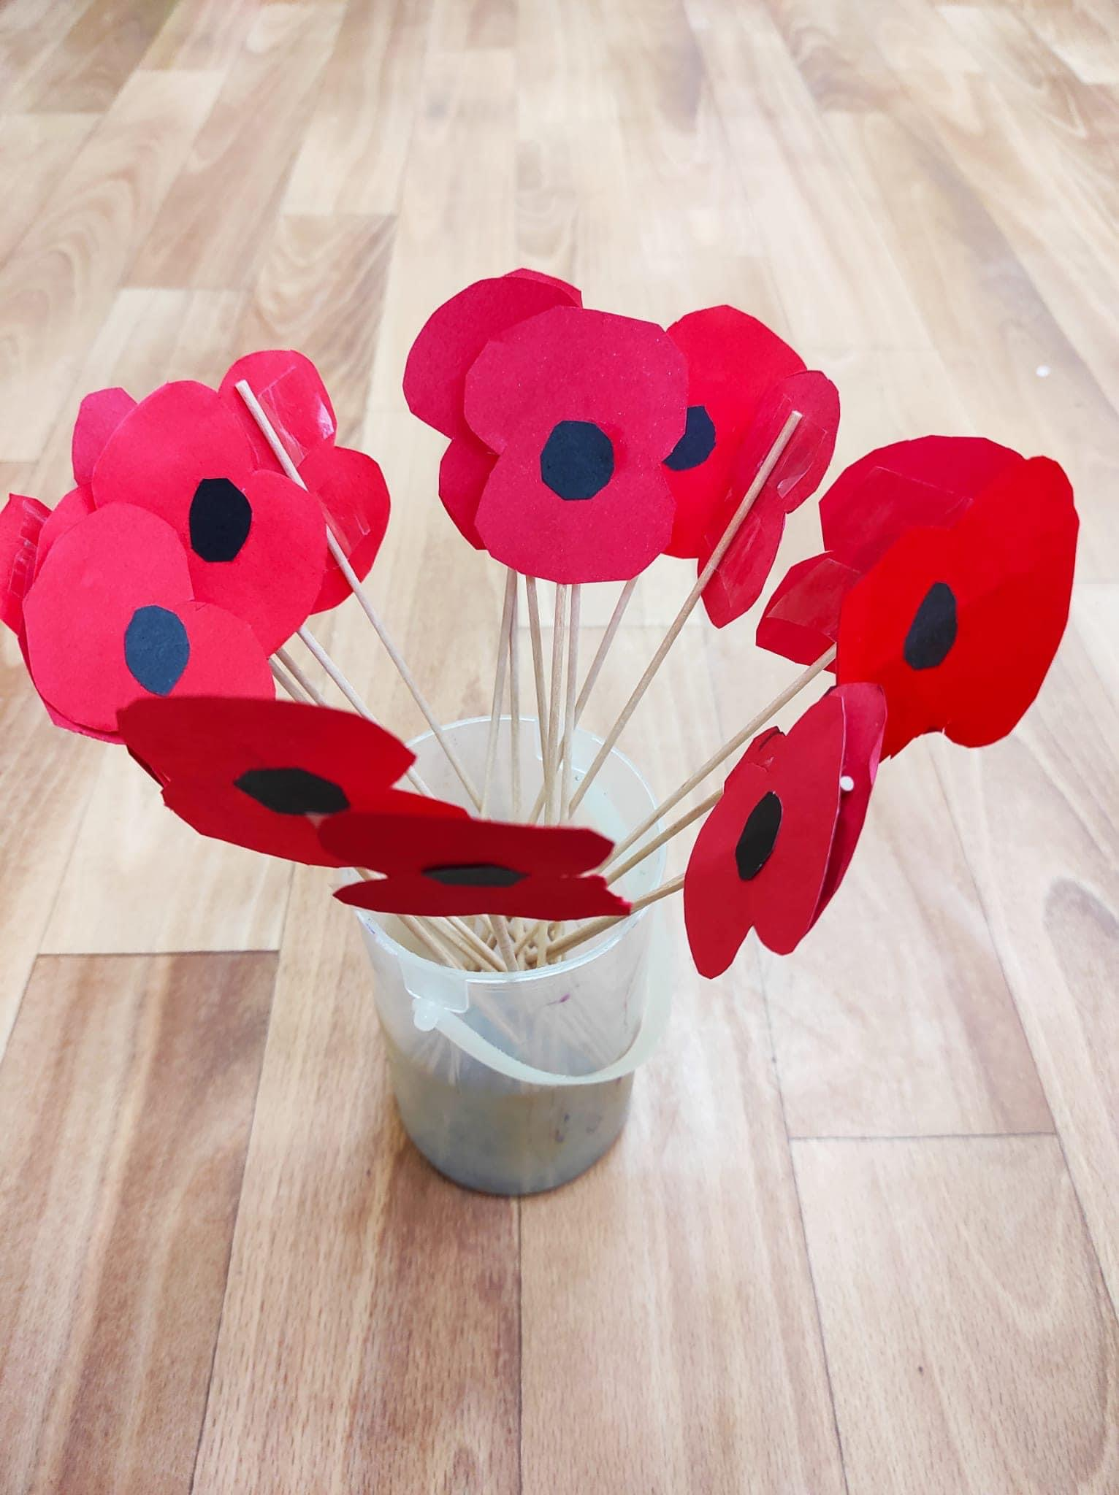
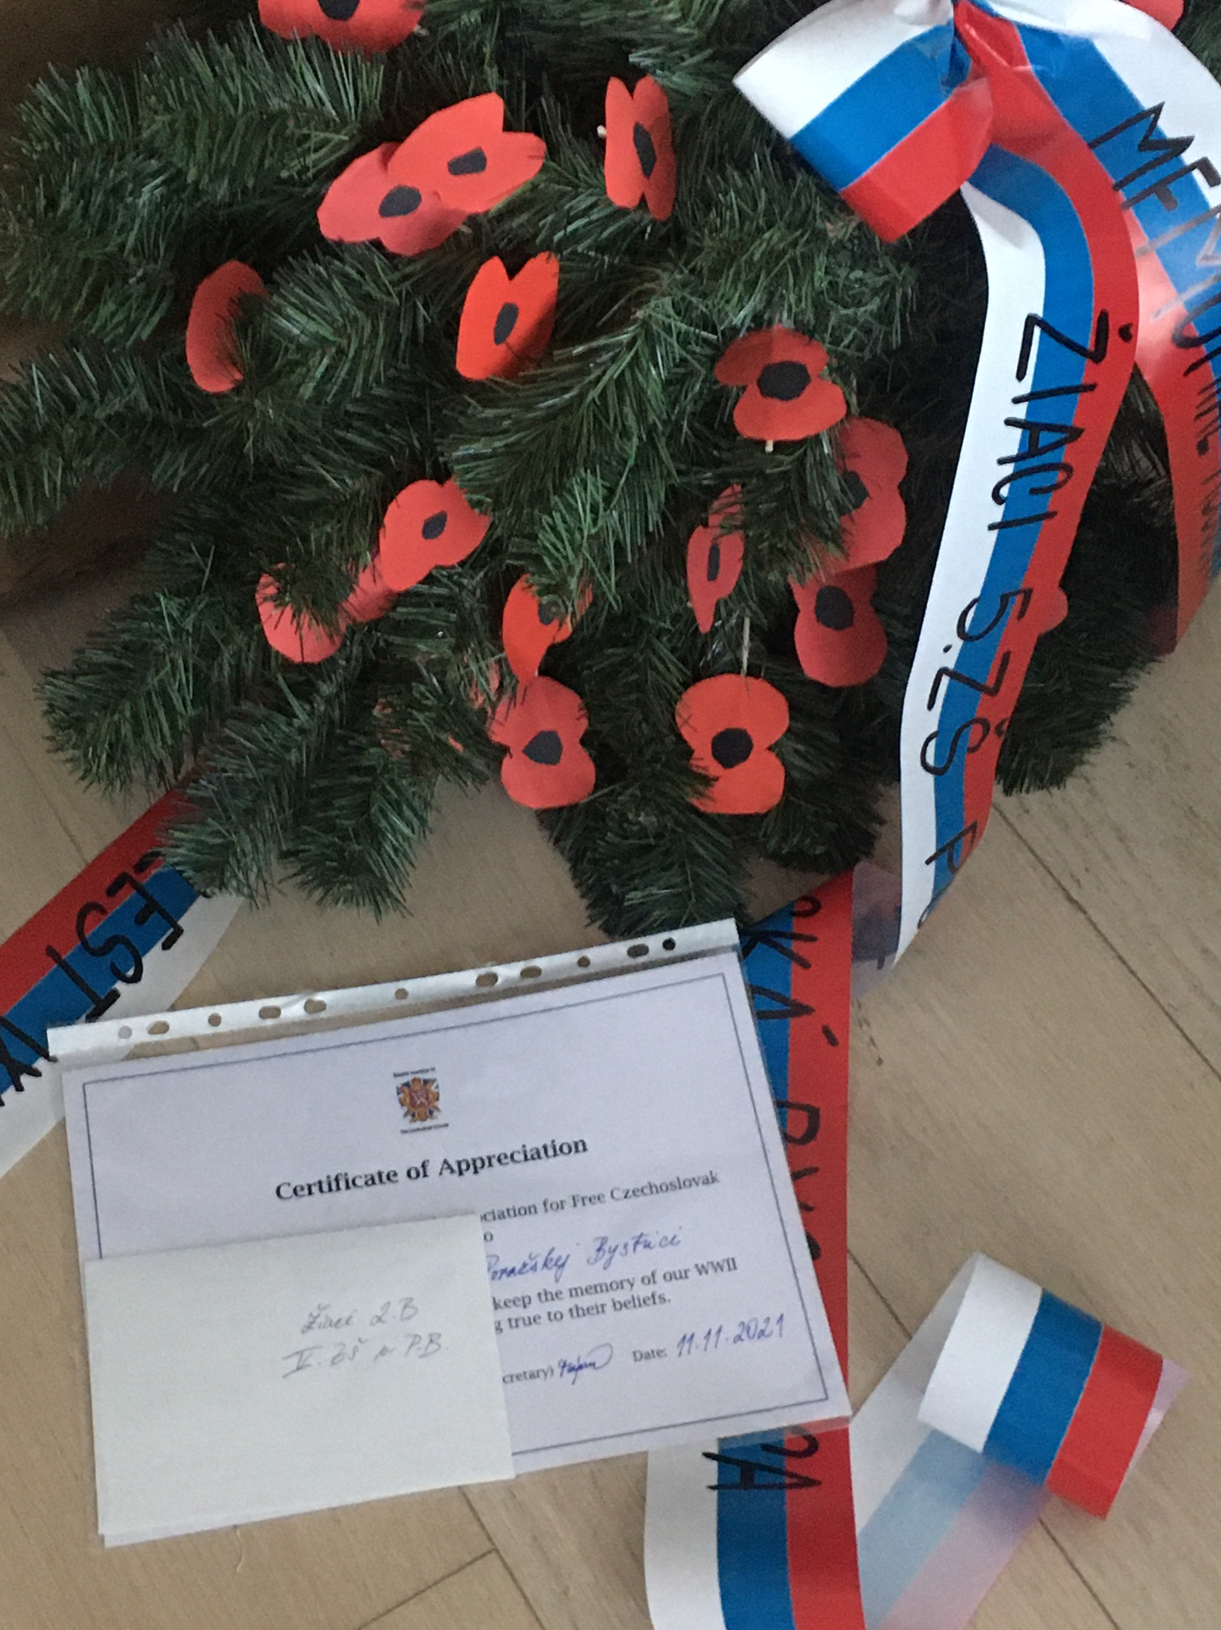
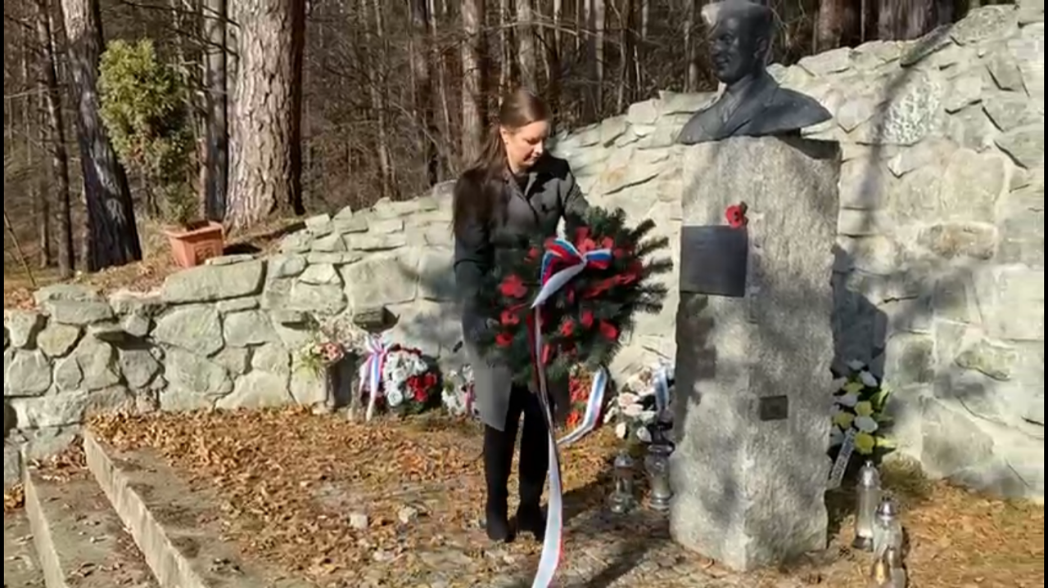
Your Mission

Slide 17
Message for future generation
“Athropoid continues as fight for freedom never ends.” Anita Moravec Gard The granddaughter of Gen. František Moravec (creator of Operation Anthropoid)
Mgr. Marta Majerčík International Secretary MAFCSVC 2022 www.mafcsv.co.uk Photos: Marta Majerčík’s personal archive, MAFCSV’s archive, Wikipedia

